Slide 1
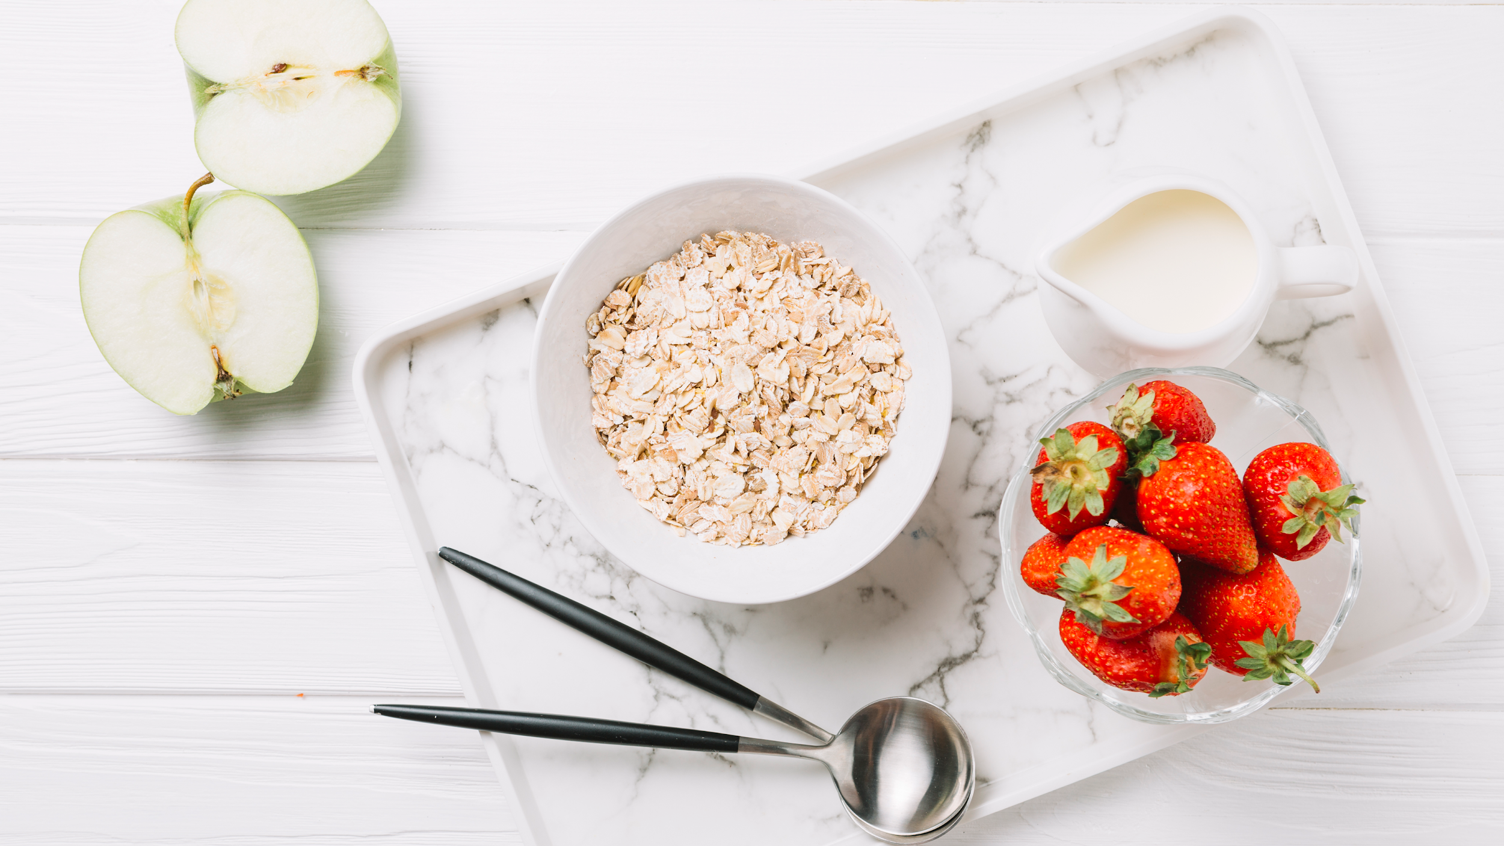
Nutrition App

Slide 2
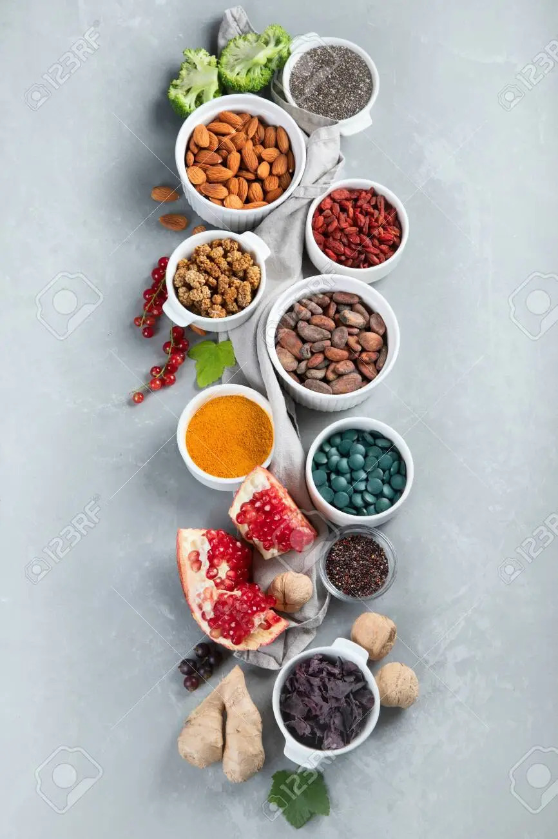
Introduction
Nutritionist App is a platform where you
can keep information of different Nutritious Food.
Users can register themselves in the
application and save search data as a logged
user and have functionality to put foods in
Favourite.

Slide 3

Application Features
Register User
Login User
Search Food Items
Mark Favourite Food Items

Slide 4

Project Architecture

Slide 5
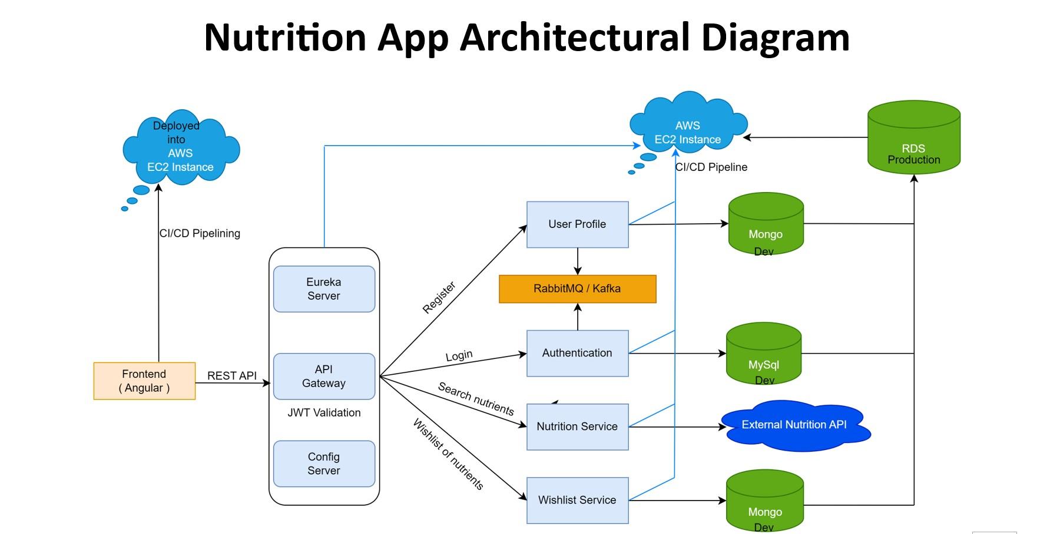

Slide 6
Microservice Decomposition

Slide 7
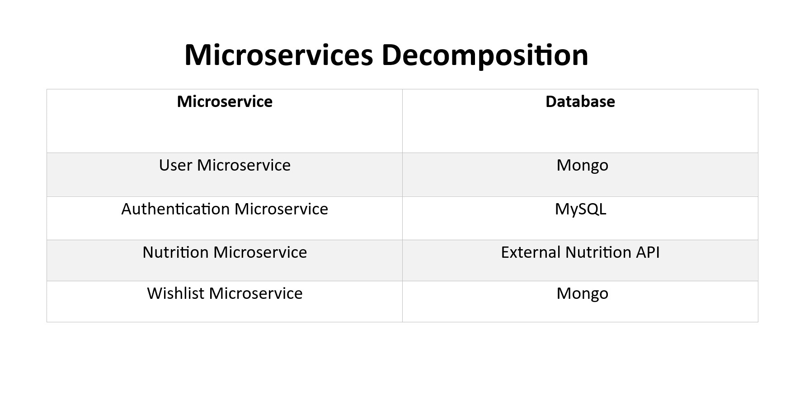

Slide 8
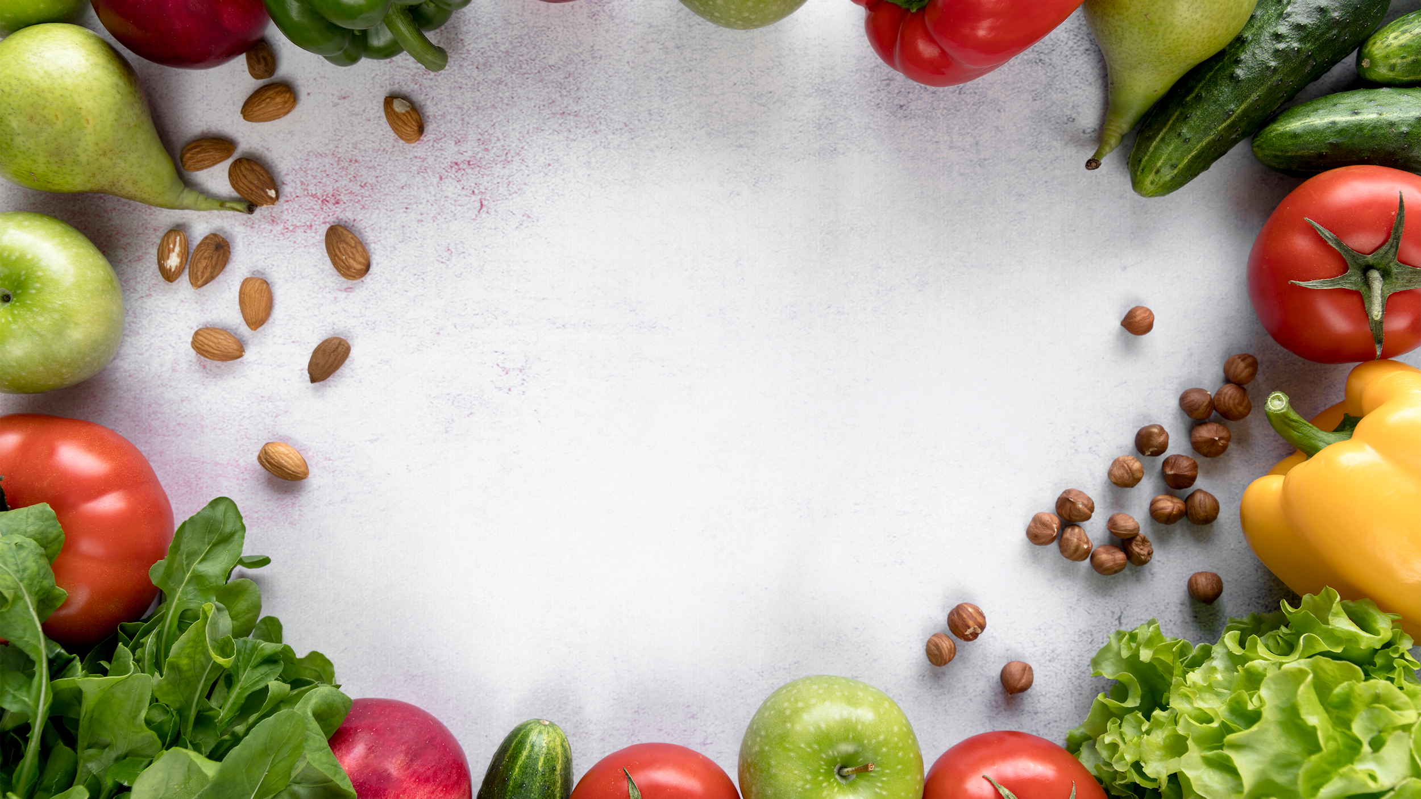
Project Data Flow

Slide 9
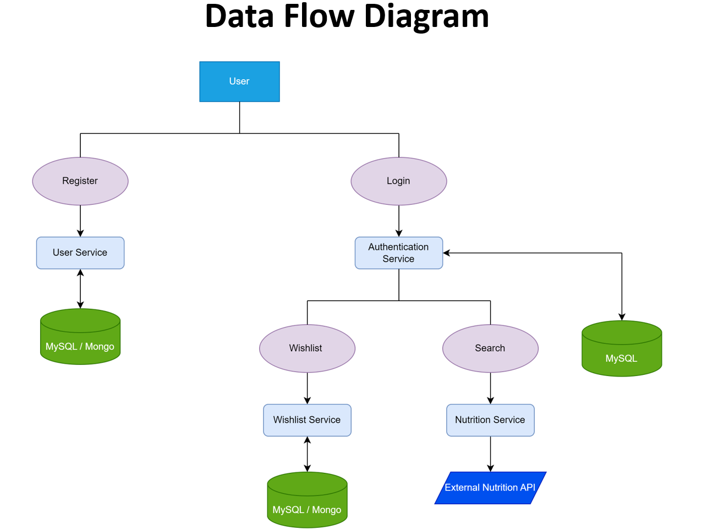
Favourite
Servce

Slide 10
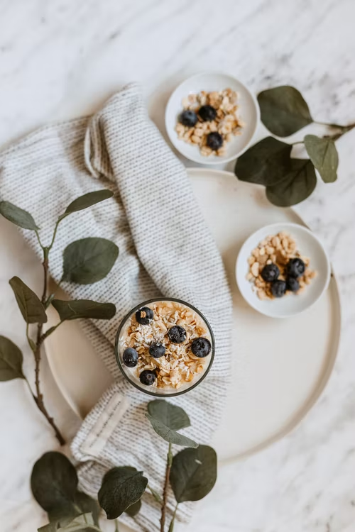
Project Data Mode

Slide 11
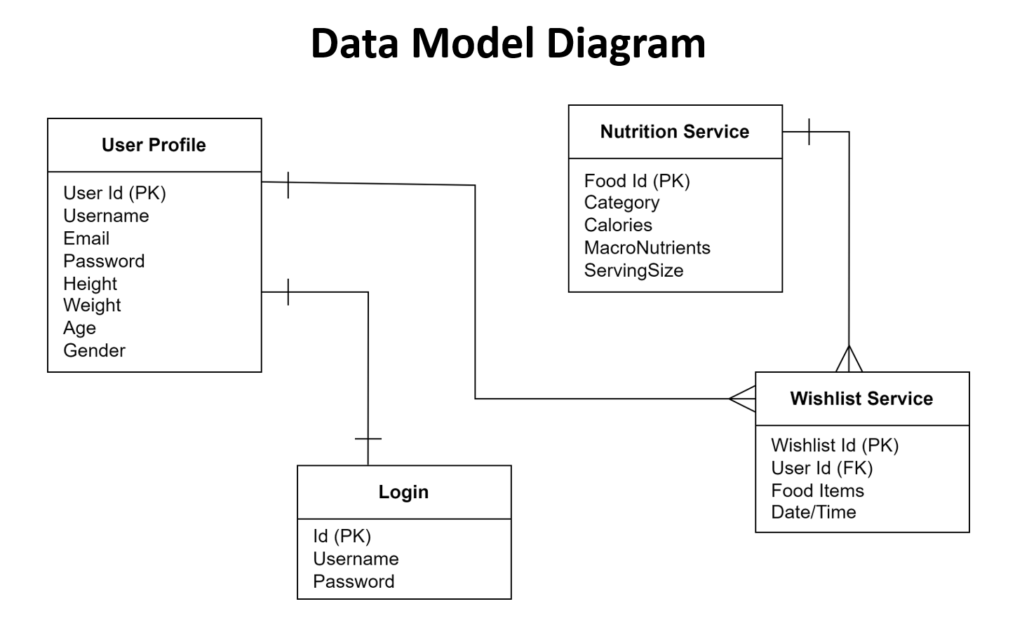
Favourite
Servce

Slide 12
Frontend Architecture

Slide 13
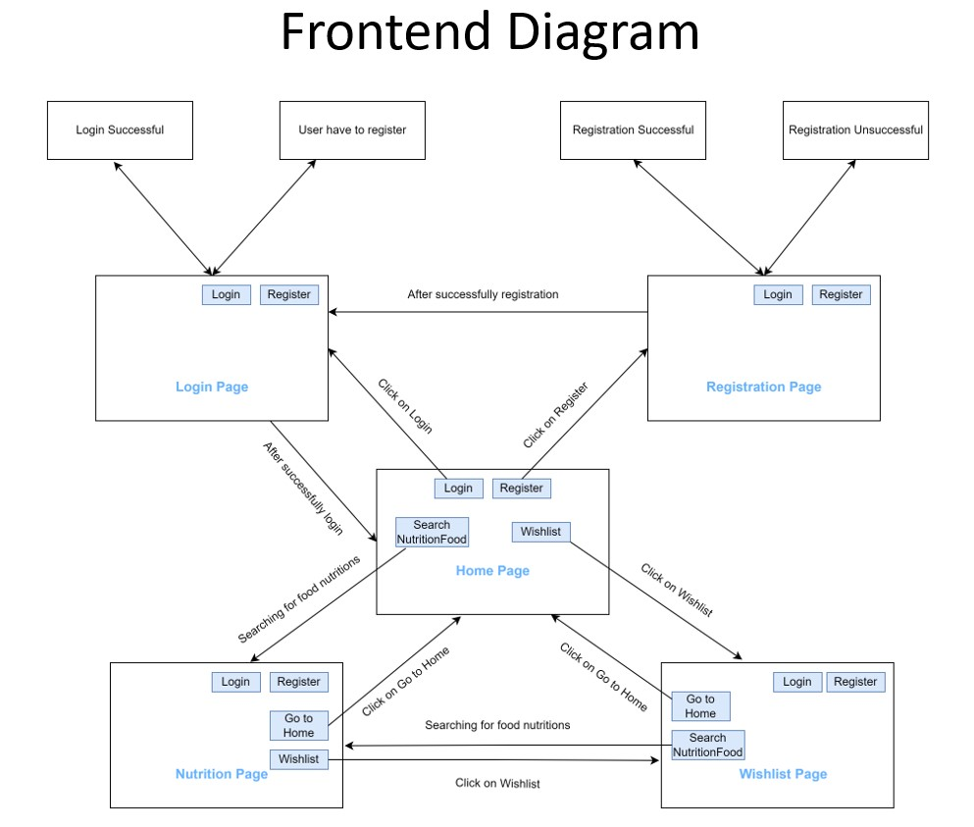

Slide 14
Cloud Deployment Architecture

Slide 15
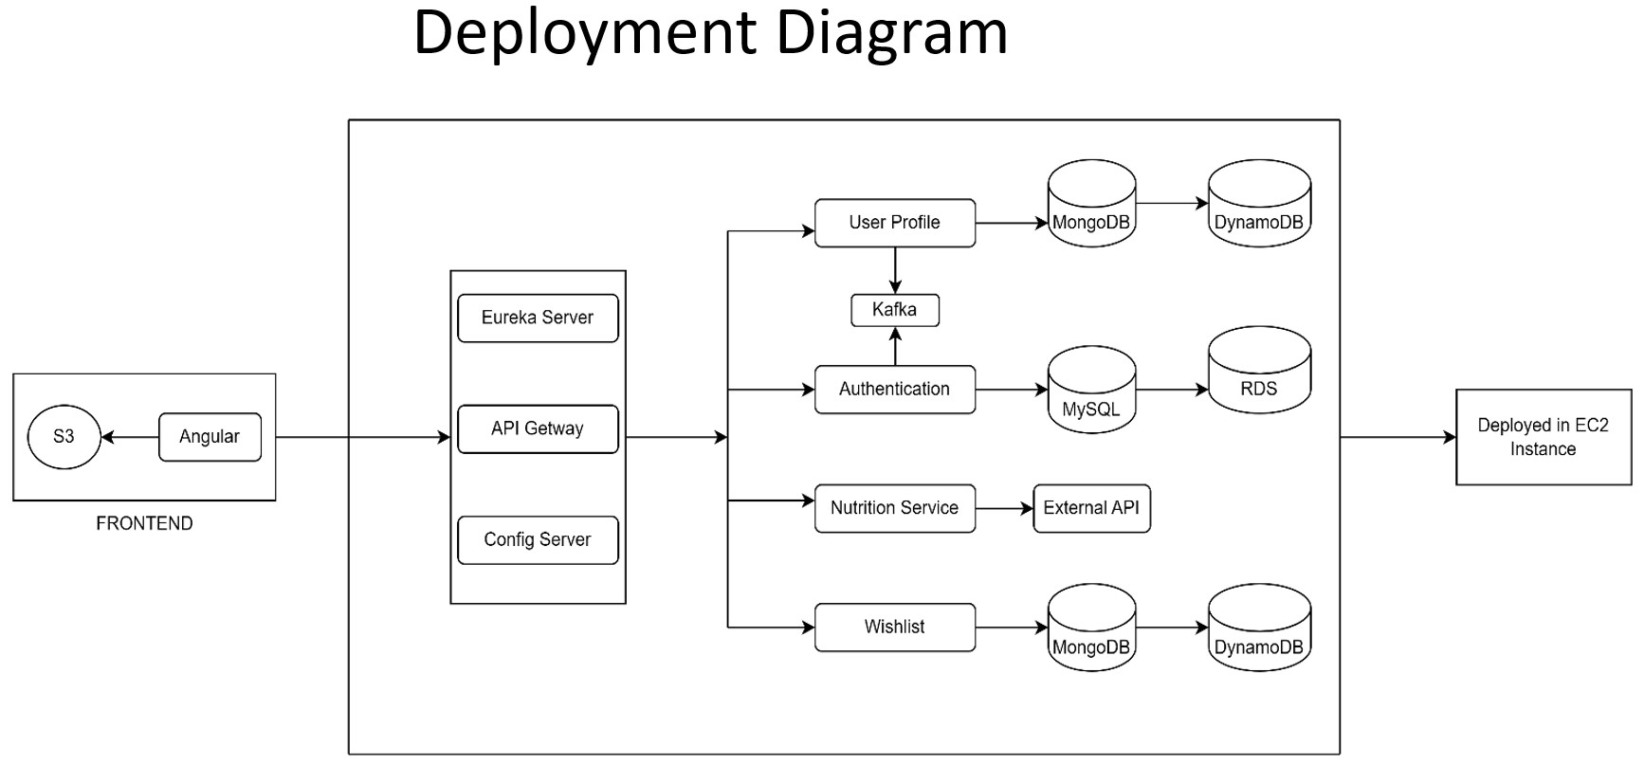

Slide 16
Frontend Deployment Process

Slide 17
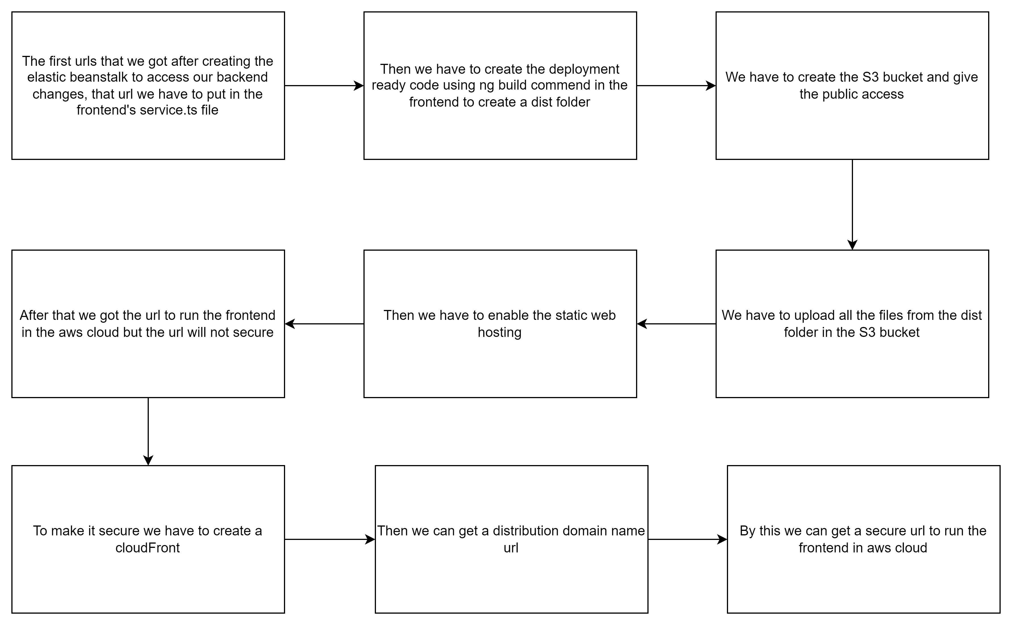

Slide 18
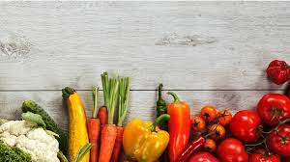



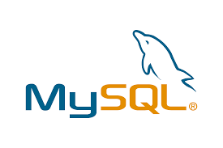








Technologies and Tool Used

Slide 19
The Nutritionist app helps the user to search for a specific food to find it’s nutrition details and also view the nutrition content for a selected food.
Conclusion

Slide 20

Thank You!

